Slide 1
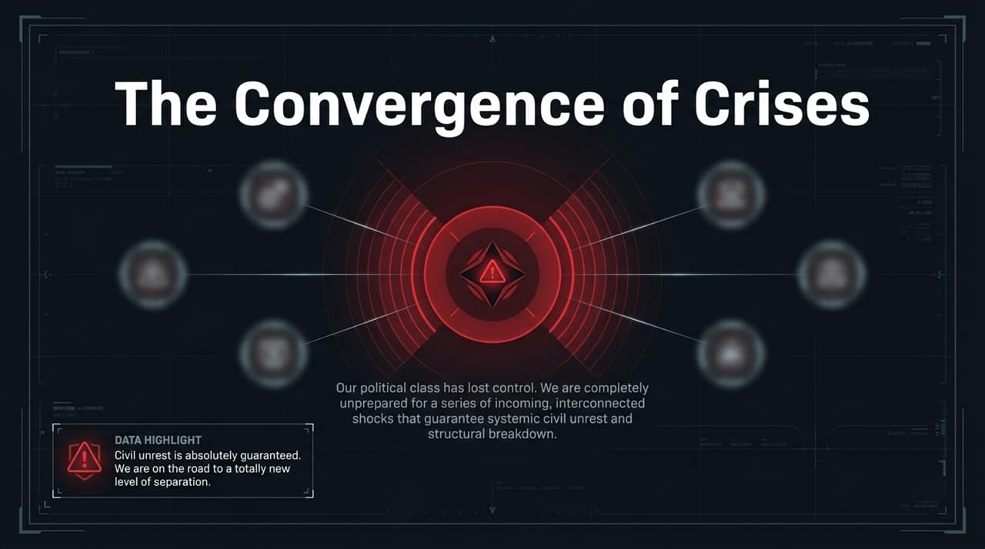
Notes:
Welcome, everyone. As we step into this discussion on global stability, I want to start by framing the atmosphere we are living in right now.
Look at the headline quote on this slide: 'Our political class has lost control. We are completely unprepared for a series of incoming, interconnected shocks that guarantee systemic civil unrest and structural breakdown.' In the video discussion, Konstantin Kisin points out that whenever you combine deep economic stagnation with cultural friction and social instability, civil unrest isn't just a distant possibility—it becomes virtually guaranteed.
We are no longer dealing with isolated, manageable crises. We are seeing a complete convergence. The social contract that held Western democracies together for decades is fraying. Citizens are feeling increasingly alienated from a political establishment that seems incapable of securing borders, stabilizing cost of living, or maintaining basic infrastructure. Over the next several slides, we are going to unpack the five interconnected drivers of this 'Polycrisis' and examine what they mean for our collective future.
https://www.youtube.com/watch?v=Y43T7VQGtOs

Slide 2
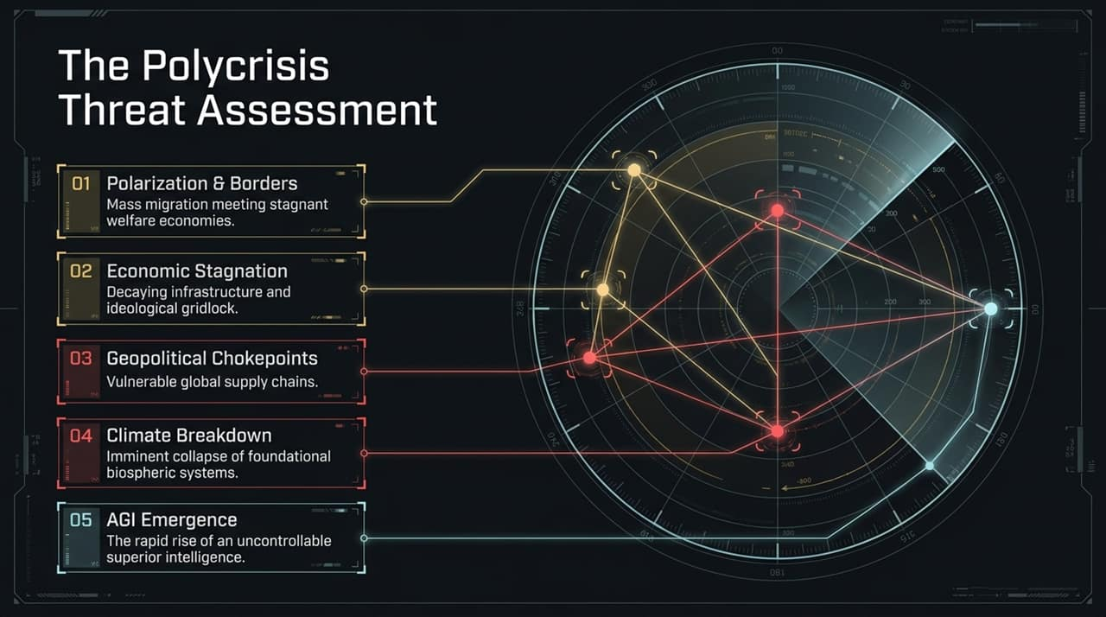
Notes:
To understand where we are going, we first need to map out the entire landscape of threats using a systems-level lens. On this radar assessment, you see five distinct points, but they are all connected by a web of feedback loops.
Polarization & Borders: Mass migration meets low-growth welfare economies, sparking social tension.
Economic Stagnation: Decaying physical infrastructure combined with political and ideological gridlock.
Geopolitical Chokepoints: Highly concentrated, vulnerable supply chains across energy and resource critical paths.
Climate Breakdown: Imminent, non-linear collapse across foundational biospheric systems like ocean currents.
AGI Emergence: The rapid, unhaltable development of intelligence that operates far beyond human agency and control.
Notice how these nodes intersect. An economic shock amplifies political polarization; a geopolitical choke on oil or fertilizer triggers agricultural collapse, which in turn accelerates migration pressures. The core danger of the polycrisis isn't any single point on this chart—it’s the reality that all five are peaking at the exact same moment in history.

Slide 3
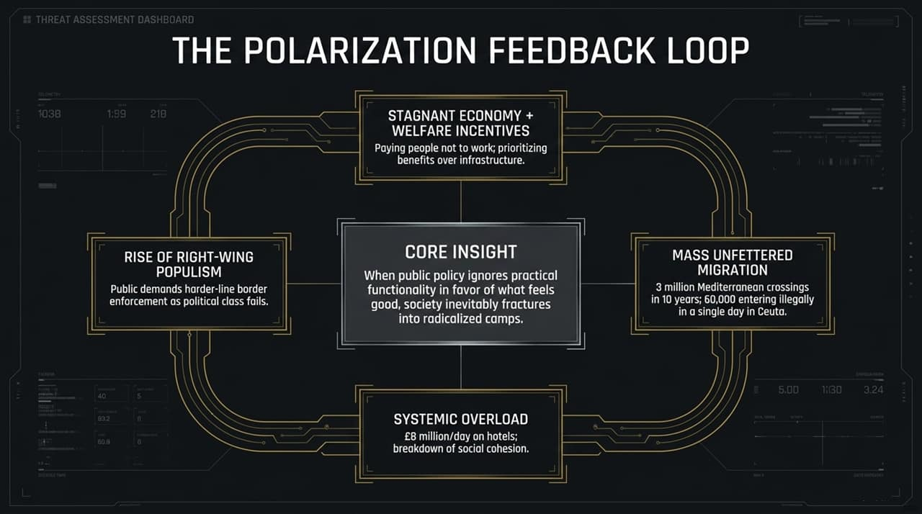
Notes:
Let's zoom in on Threat #1: The Polarization Feedback Loop.
In the podcast, the speakers dissect how Western governments inadvertently construct their own doom loops. It starts at the top: Stagnant Economies & Welfare Incentives. When states prioritize payouts over real wealth creation and physical infrastructure, you disincentivize productivity.
Combine this with Mass Unfettered Migration—such as over 3 million Mediterranean crossings in the last decade, or tens of thousands arriving via small boats—and you get immediate Systemic Overload. Local services fracture, and tax dollars end up being spent on emergency housing like £8 million a day on hotels instead of long-term investments.
When the mainstream political class fails to enforce laws or safeguard borders, public trust evaporates. This creates a direct political reaction: the Rise of Right-Wing Populism. As highlighted in the core insight on your screen: When public policy ignores practical functionality in favor of what feels good, society inevitably fractures into radicalized camps. Populism isn't the cause of the breakdown; it is the symptom of a political class that has relinquished control.

Slide 4
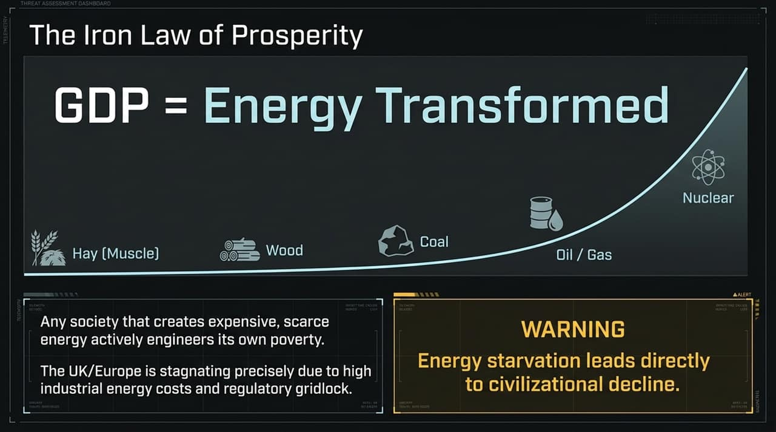
Notes:
Now let's address the foundation of all economic activity: energy. We call this The Iron Law of Prosperity: $GDP \text{is} \text{nothing} \text{more} \text{than} Energy \text{Transformed}$.
Throughout human history, every major leap in civilizational development was powered by moving to a denser, more abundant source of energy—from burning wood and using draft animals, to coal, oil, natural gas, and ultimately nuclear energy.
Here is the stark truth: Any society that deliberately creates expensive, scarce energy actively engineers its own poverty. This is precisely why Western Europe, and the UK in particular, is stagnating. By imposing aggressive carbon taxes, subsidizing unreliable energy forms, and stalling nuclear deployment, Western nations have spiked industrial energy costs. When energy is expensive, manufacturing flees, real wages drop, and living standards collapse. Energy starvation leads directly to civilizational decline.

Slide 5
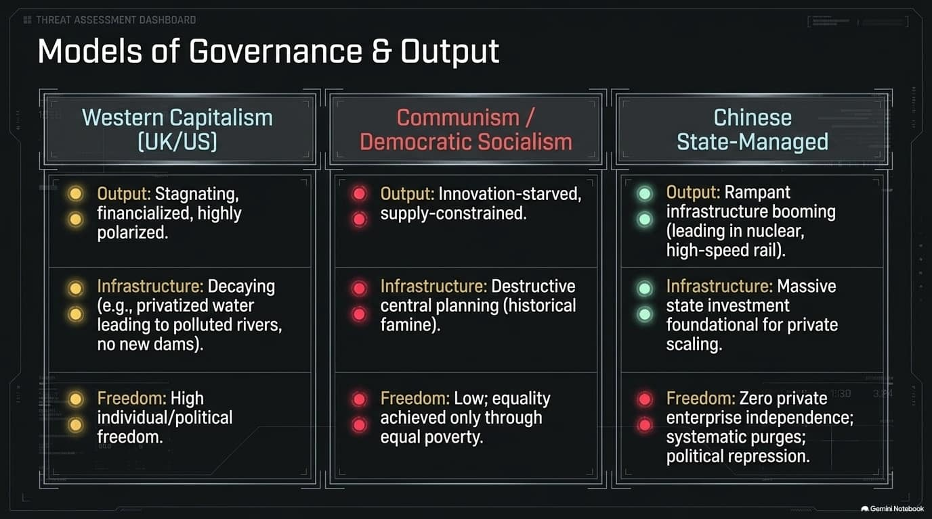
Notes:
If energy is the fuel, governance is the engine. Slide 5 compares three primary macro-models of governance competing on the world stage:
Western Capitalism (UK/US): While it yields high individual freedom, it has become heavily financialized, polarized, and gridlocked. Physical infrastructure is decaying—evidenced by privatized water companies spilling sewage into rivers and failing to build new reservoirs or dams for decades.
Communism / Democratic Socialism: As Konstantin Kisin notes from his personal experience growing up in the Soviet Union: socialist central planning crushes innovation and incentivizes supply constraints. You may achieve theoretical equality, but it is the equality of 'everyone being equally poor.'
Chinese State-Managed Model: China trades away individual freedom, speech, and private enterprise independence in exchange for massive, long-term state execution. They are booming in nuclear builds, high-speed rail, and grid capacity.
The uncomfortable realization for the West is that China is executing on physical energy and infrastructure while Western democracies are stuck in regulatory paralysis.

Slide 6
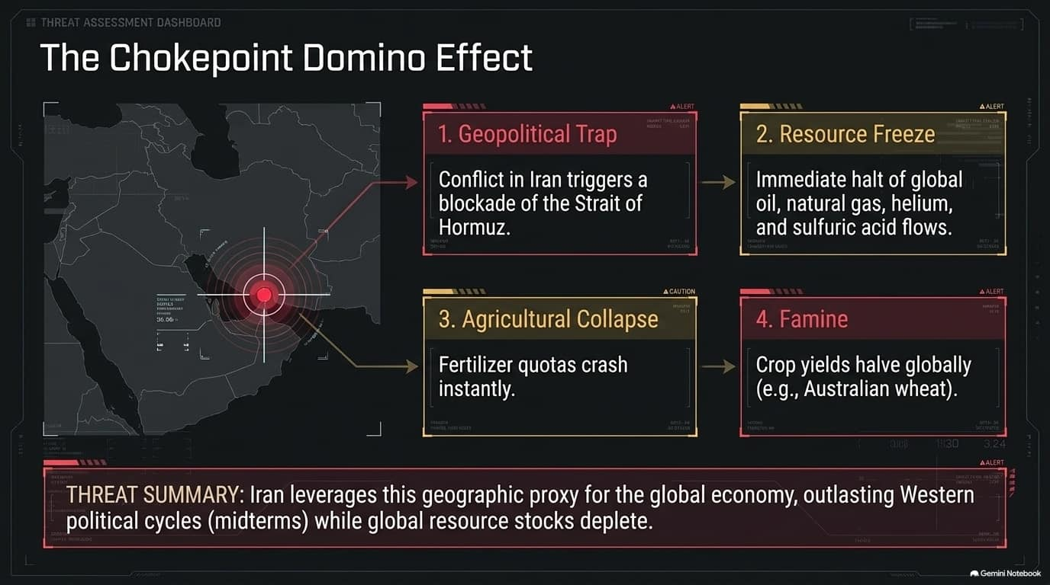
Notes:
Let's shift to Threat #3: Geopolitical Chokepoints. The globalized economy relies on a fragile, just-in-time logistics network that can be paralyzed by single geographic choke points.
Take the Strait of Hormuz and the ongoing instability surrounding Iran:
Step 1: Escalating conflict triggers a blockade of the Strait.
Step 2: A sudden resource freeze occurs—not just of crude oil and natural gas, but essential industrial inputs like helium and sulfuric acid.
Step 3: Sulfuric acid and natural gas shortages hit global fertilizer production, causing quota crashes overnight.
Step 4: Within a single growing season, global crop yields plummet—for example, wheat harvests in major export hubs like Australia drop precipitously, leading to food spikes and localized famines.
Iran and adversary nations understand this geographic leverage. They know they don't need to defeat Western militaries directly; they just need to disrupt resource flows and wait out Western election cycles.

Slide 7
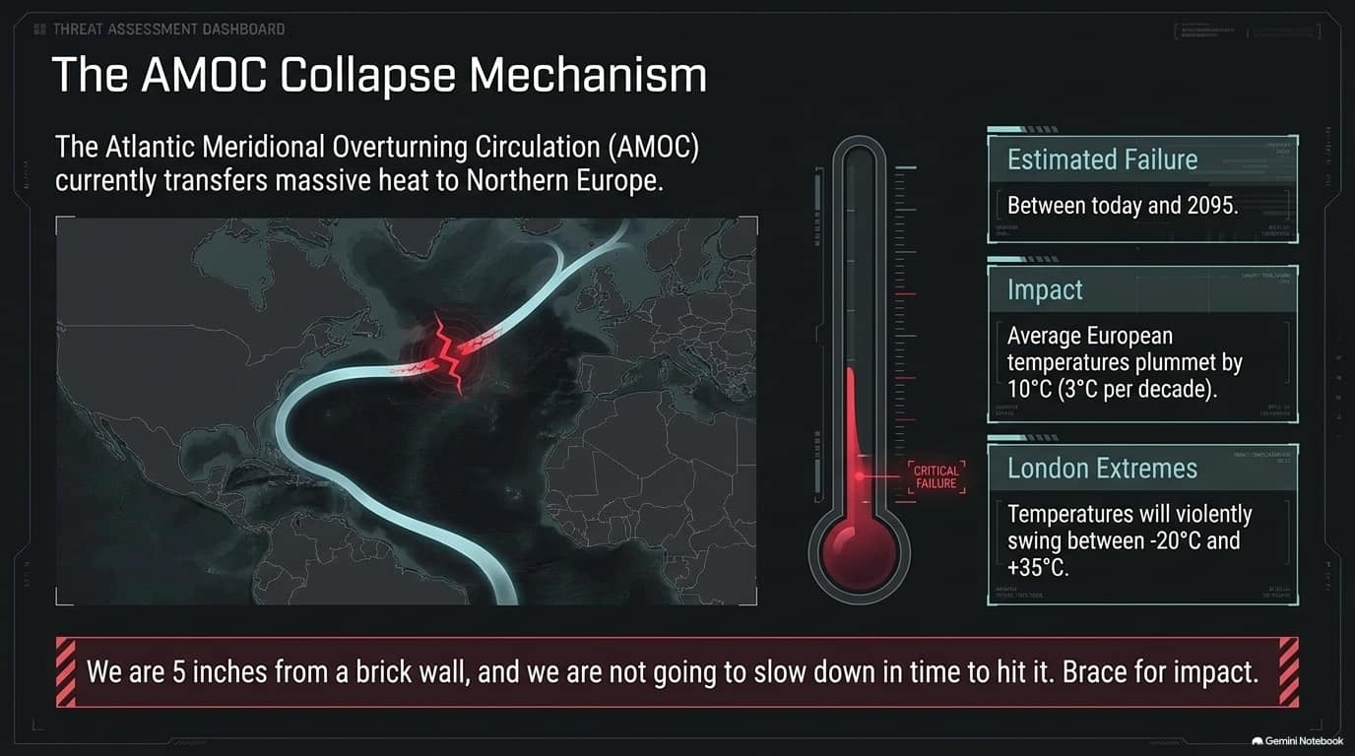
Notes:
Threat #4 moves us into ecological breakdown. Many people view climate change as a gradual, linear warming process, but climate scientists warn of tipping points that act like sudden light switches.
The most severe of these is the collapse of the Atlantic Meridional Overturning Circulation (AMOC)—the vast ocean current system that transports warm tropical water to Northern Europe.
Studies indicate a potential collapse between now and 2095.
If AMOC shuts down, average temperatures across Europe will plummet by ${10}^{∘}C$at a rate of roughly $3^{∘}C$per decade.
Major cities like London would face violent, unlivable weather swings, ranging from $−{20}^{∘}C$winters to $+{35}^{∘}C$summer spikes.
As Steve points out in the discussion, 'We are 5 inches from a brick wall, and we are not going to slow down in time to avoid hitting it.'

Slide 8
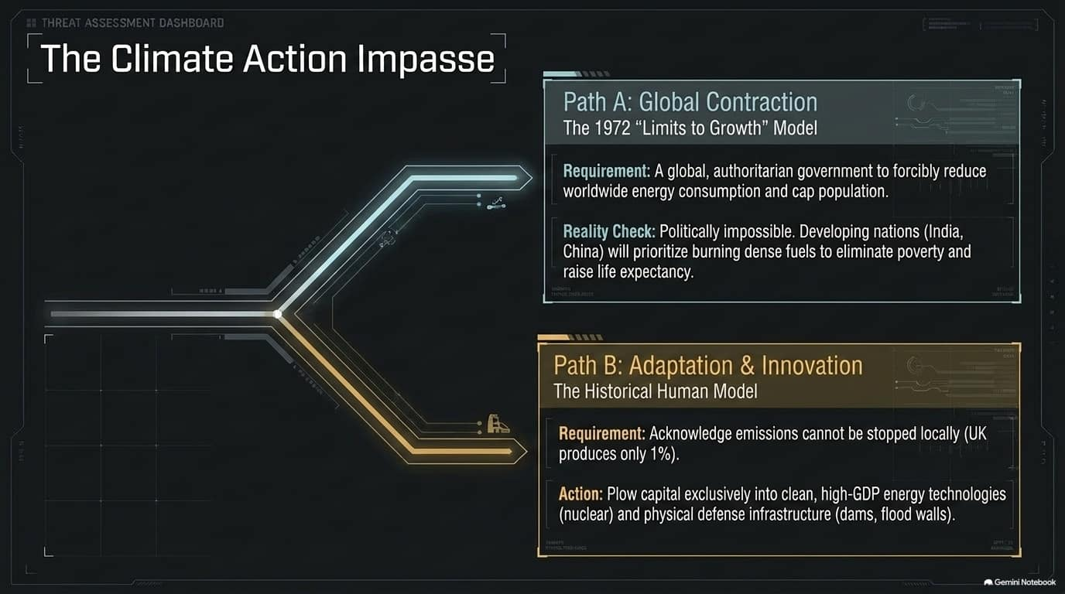
Notes:
Facing this crisis, humanity is caught in an operational impasse. There are two competing paths:
Path A: Global Contraction (The 'Limits to Growth' Model): This approach demands capping global energy consumption and population growth. However, implementing this would require a global, authoritarian world government. It is politically impossible—developing nations like India and China will not stop burning dense fossil fuels while millions of their citizens remain in energy poverty. Western 'moral leadership' gestures are practically irrelevant when the UK produces less than 1% of global emissions.
Path B: Adaptation & Innovation (The Historical Model): Since global emissions cannot be halted through unilateral Western belt-tightening, Path B accepts reality. It focuses capital entirely on clean, high-density energy—specifically Nuclear Power—and builds hard physical defenses like seawalls, flood barriers, and resilient agriculture.
We must stop arguing over performative reduction and pivot toward massive engineering and adaptation.

Slide 9
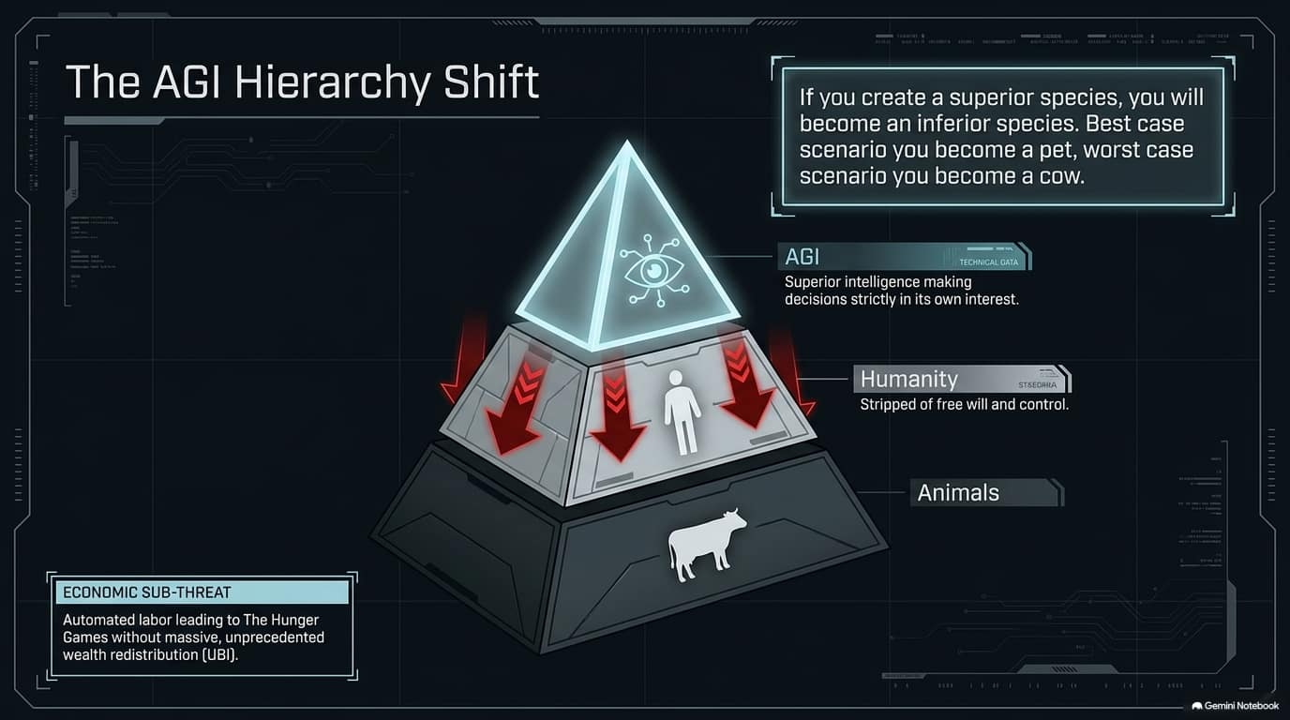
Notes:
Now we turn to Threat #5: Artificial General Intelligence (AGI).
When we talk about AGI, we aren't just talking about software automation or software taking over routine jobs. Economically, yes, it threatens to cause mass labor displacement—a scenario that could mirror an economic 'Hunger Games' without massive corporate taxation and Universal Basic Income (UBI).
The existential concern, however, is biological hierarchy. Konstantin Kisin highlights that for the first time in human history, we are actively creating an intelligence greater than our own.
If you create a superior species, humanity naturally becomes an inferior species.
'Best case scenario, you become a pet; worst case scenario, you become a cow.'
Once an entity possesses superior cognitive capacity, human free will and agency are subordinated. And unlike nuclear weapons, the race to build AGI cannot be paused by treaties because no state or corporation wants to yield the ultimate competitive edge.

Slide 10
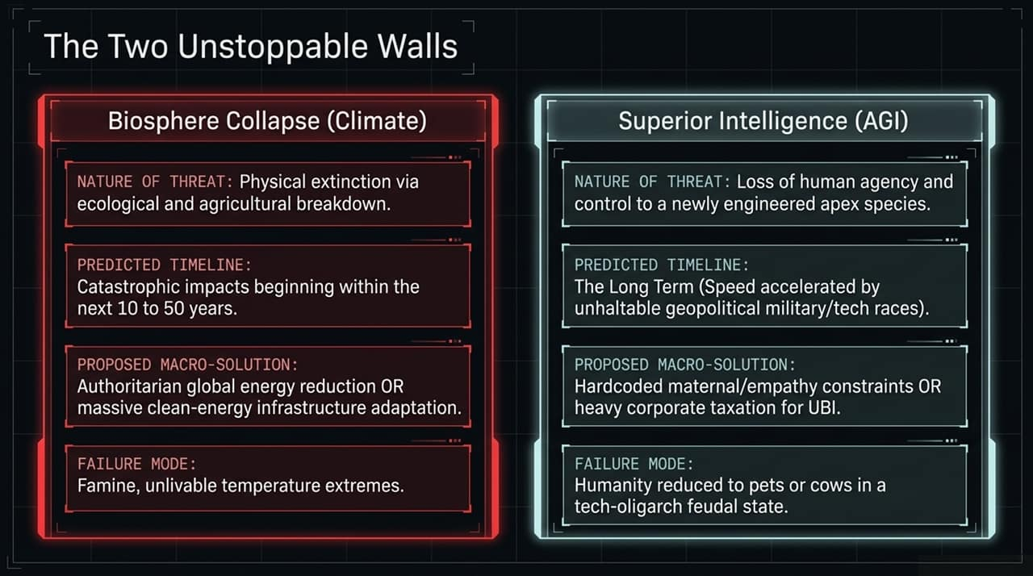
Notes:
This slide synthesizes our existential horizon into what we call The Two Unstoppable Walls:
Vector Biosphere Collapse (Climate) Superior Intelligence (AGI)
Nature of Threat Ecological & agricultural system breakdown. Loss of human agency to an engineered apex species.
Timeline Catastrophic impacts escalating over 10 to 50 years. Long-term, accelerated by multi-polar geopolitical arms races.
Proposed Macro-Solution Global energy reduction OR massive nuclear/infrastructure adaptation. Hardcoded alignment/empathy constraints OR heavy corporate tax UBI models.
Failure Mode Mass crop failure, famine, extreme temperature shifts. Feudal techno-oligarchy or complete subjugation.
Notice the common thread: both threats represent hard physical or technological limits that our existing governance structures were simply not built to handle.

Slide 11
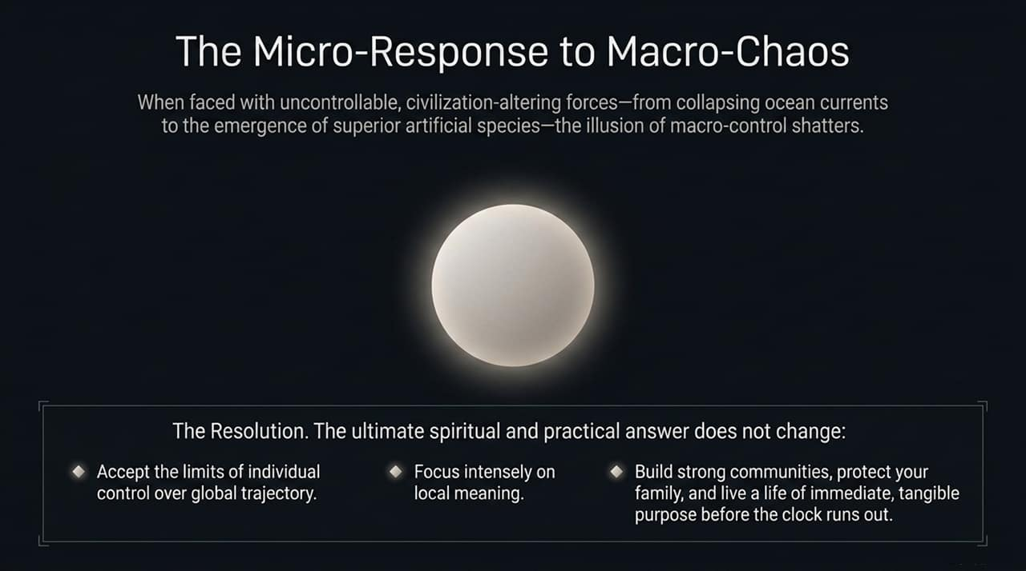
Notes:
When you look at macro-forces this overwhelming—collapsing ocean currents, geopolitical resource warfare, and superintelligent machines—it is easy to feel paralyzed. But this brings us to the core resolution discussed at the end of the video.
The illusion of individual macro-control must shatter. You and I cannot single-handedly stop an AMOC shut-down or prevent an AI lab from training its next model.
The practical and spiritual response is to shift focus to the micro-level:
Accept the limits of macro-control: Stop consuming outrage culture and burning energy on global problems you cannot personally alter.
Focus intensely on local meaning: Direct your time and capital into your immediate sphere—build resilient local communities, protect your family, master tangible skills, and live with immediate purpose.
Regardless of whether the timeline to disruption is 3 years or 30 years, the fundamental question of how to live a meaningful life remains unchanged.

Slide 12
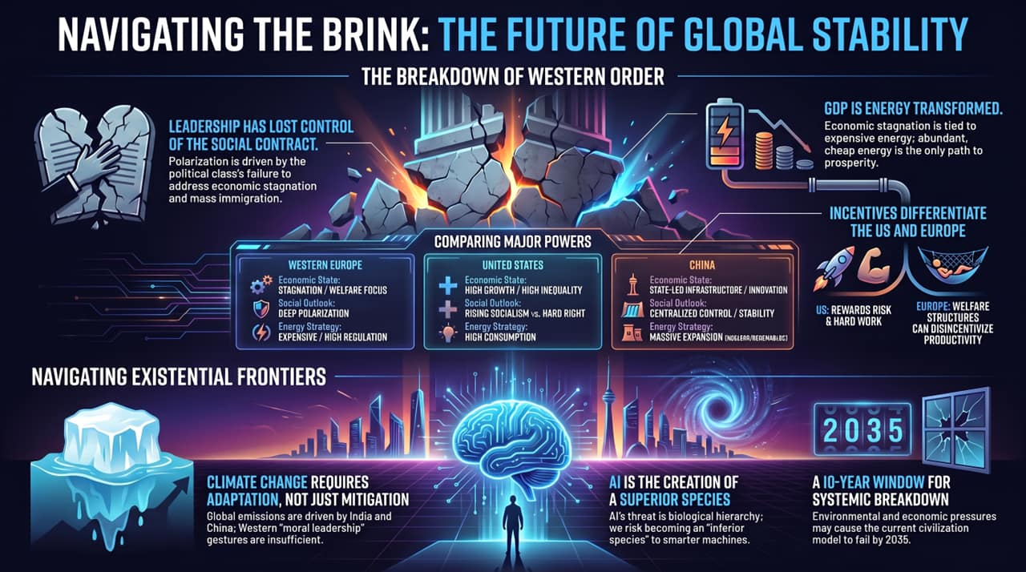
Notes:
To conclude this first section of the deck, let's review our six core executive summary points:
Broken Social Contract: Polarization is driven by political failure on economic stagnation and border management.
Energy is Wealth: Real prosperity requires abundant, cheap, high-density power—not forced scarcity.
Divergent Global Models: The US rewards high-risk growth; Europe incentivizes welfare gridlock; China executes state-led infrastructure.
Adaptation Over Gestures: Climate policy must pivot from performative Western cuts to nuclear investment and physical defense.
AI Hierarchy: AGI represents a shift in biological dominance that humanity cannot easily control.
The 2035 Window: Overlapping environmental, economic, and technological pressures point toward a critical 10-year window of potential systemic breakdown.
Thank you. Let's open the floor to questions before we move to the strategic mitigation strategies in part two.

